Slide 1
Chapter -1
Introduction

Slide 2
Learning outcomes
What are the two stages of the visual system?
How do luminance and colour effect visual perception?
What is the difference between central and peripheral vision?
How do we read?

Slide 3
How do we realize design?
What should we consider?
Technical
Visual
Interaction
Search
Context of use
Information
Interacting/ transacting

Slide 4
Realizing the visual interface
Human visual systems
Visual aesthetics
Grouping
Lines Borders & Tables
Text
Colour and Images
Forms and Controls

Slide 5
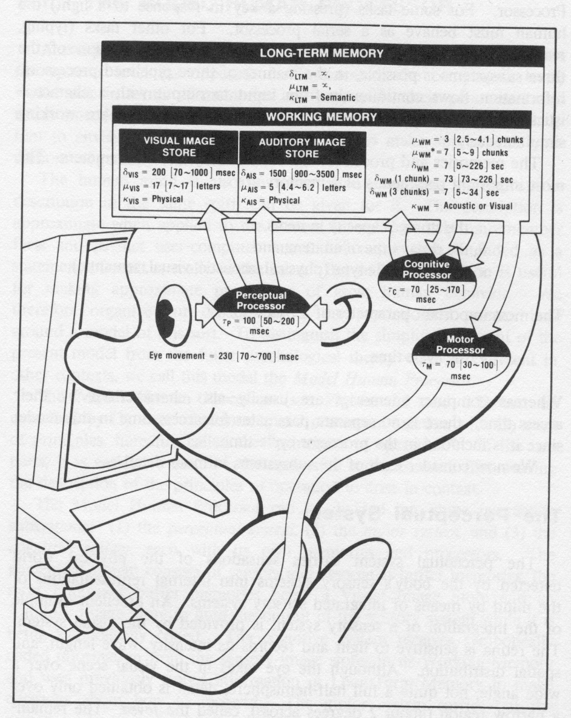
The human processor
Input
senses
Process
Cognition
Knowledge
Skills
Reasoning
Storage
Memory
Output
Actions
Speech

Slide 6
Senses
Computer devices
Input output
Human
Vision
Hearing
Smell
Taste
Touch
Kinaesthetic / proprioception

Slide 7





Current computer systems
Mostly output is to a visual display.
And the display is also the input medium on phones etc!
Exceptions
Sound
Vibrate

Slide 8
Vision
Two stages in vision
• physical reception of stimulus
• processing and interpretation of stimulus

Slide 9

The Eye - physical reception
mechanism for receiving light and transforming it into electrical energy
light
Reflects from objects (e.g. paper)
Or is produced from a light source (e.g. a display)
images are focused upside-down on retina
retina contains rods for low light vision and cones for colour vision
ganglion cells (brain!) detect pattern and movement
Interesting web site http://www.hhmi.org/senses

Slide 10

Interpreting the signal (cont)
Luminance (Brightness)
subjective reaction to levels of light
affected by luminance of object
visual acuity increases with luminance as does flicker
Colour
made up of hue, intensity, saturation
cones sensitive to colour wavelengths
blue acuity is lowest
8% males and 1% females colour blind are severely colour blind

Slide 11
Luminance (Brightness)
Rods provide low-light monotone (grey scale) vision. Rods are saturated in bright light and contribute little or nothing to what you see.
However the principles of brightness and contrast are equally important with colour vision.

Slide 12
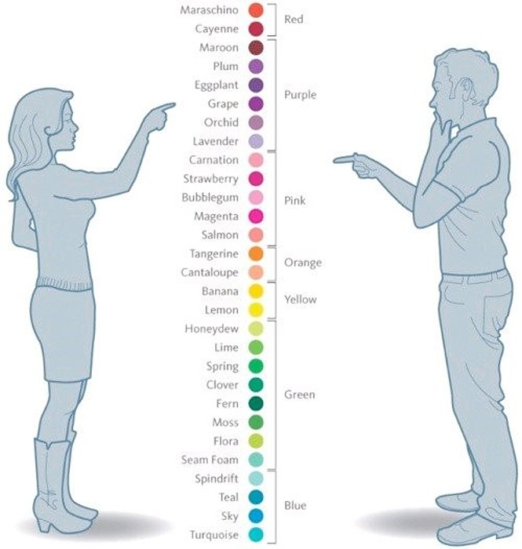
Colour and gender
Women see more colours than men (on average)
Perhaps 80% of men are colour blind .. depending on how you measure it. ☺
There is a difference between seeing the colours on a chart and seeing them in isolation

Slide 13

Oops

Slide 14
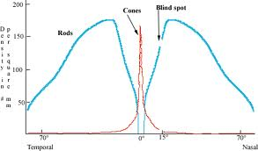
Central versus peripheral vision
Central
Peripheral
More cone cells
Better detail and focus
Less cells in general and more rod cells
Good movement detection

Slide 15
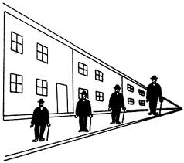
Interpreting the signal
Size and depth
visual angle indicates how much of view object occupies (relates to size and distance from eye)
visual acuity is ability to perceive detail (limited)
familiar objects perceived as constant size in spite of changes in visual angle when far away)
cues like overlapping help perception of size and depth
What does this mean for items on the screen periphery?

Slide 16
Interpreting the signal (cont)
The visual system compensates (to some degree) for:
movement
changes in luminance.
Context is used to resolve ambiguity
Optical illusions sometimes occur due to over compensation

Slide 17


Optical Illusions
http://michaelbach.de/ot/

Slide 18
Reading
Several stages:
visual pattern perceived
decoded using internal representation of language
interpreted using knowledge of syntax, semantics, pragmatics
Reading involves saccades and fixations
Perception occurs during fixations
Word shape is very important to recognition
There are two main theories about how we read, one from psychology and one from typography… suffice to say, that either way the same things are important

Slide 19
Word shapes

Slide 20
What if ….
Your visual attention is need for another activity
Driving & cell phone / gpa navigation….
Are colour blind?
Needed reading glasses?
Have really poor eye sight that cannot be corrected by glasses?
You are blind?

Slide 21

A Visualization Pipeline
Data acquisition
Data are generated/collected.
Data enhancement
Data are processed.
Data are mapped to visual primitives, e.g. colors,
geometry, etc.
Visualization mapping
Rendering (ND->2D)
Images are generated.

Slide 22

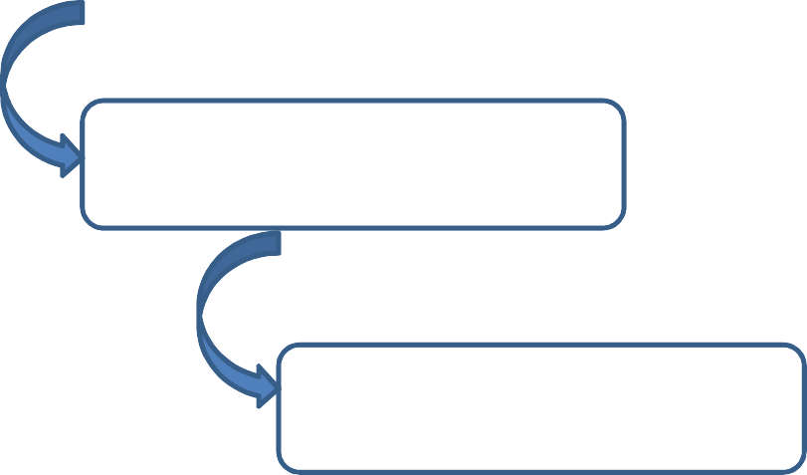
Data Visual Analytic Pipeline
Data acquisition
Data are generated/collected.
Data are pre-processed.
Data pre-processing
Feature detection Structure extraction Statistical analysis
etc.
Data are mapped to visual primitives, e.g. colors,
geometry, etc.
Analysis
Visualization mapping
Rendering (ND->2D) Images are generated.

Slide 23
Evolution of Visualization Research
From direct visualization to derived information visualization.
From simple data to more complex ones.
From represent the data with fidelity to reveal new findings.
From scientific visualization to information visualization, bio-visualization, geographical data visualization, and beyond.

Slide 24
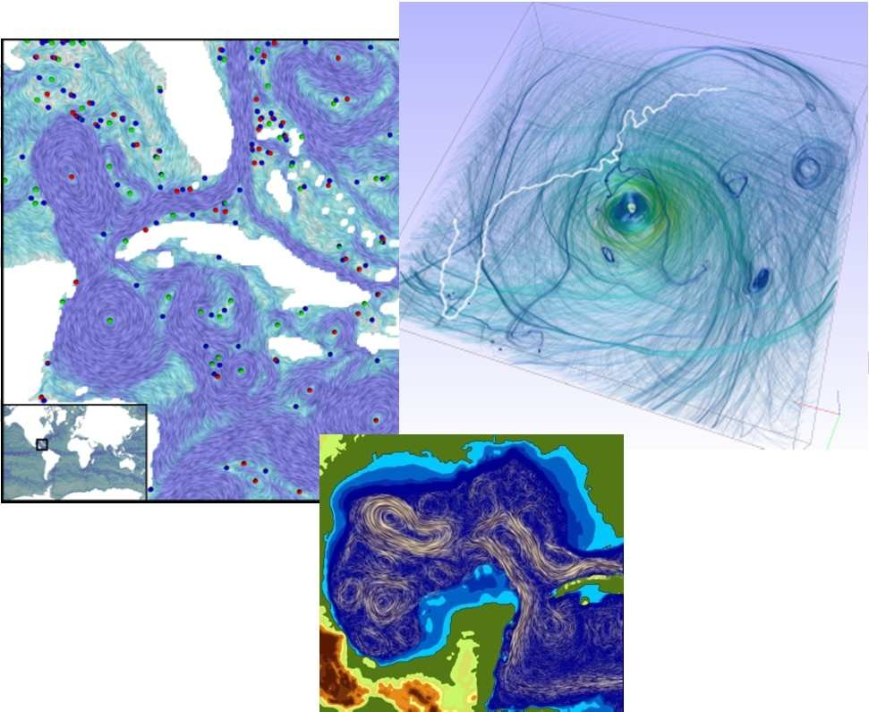
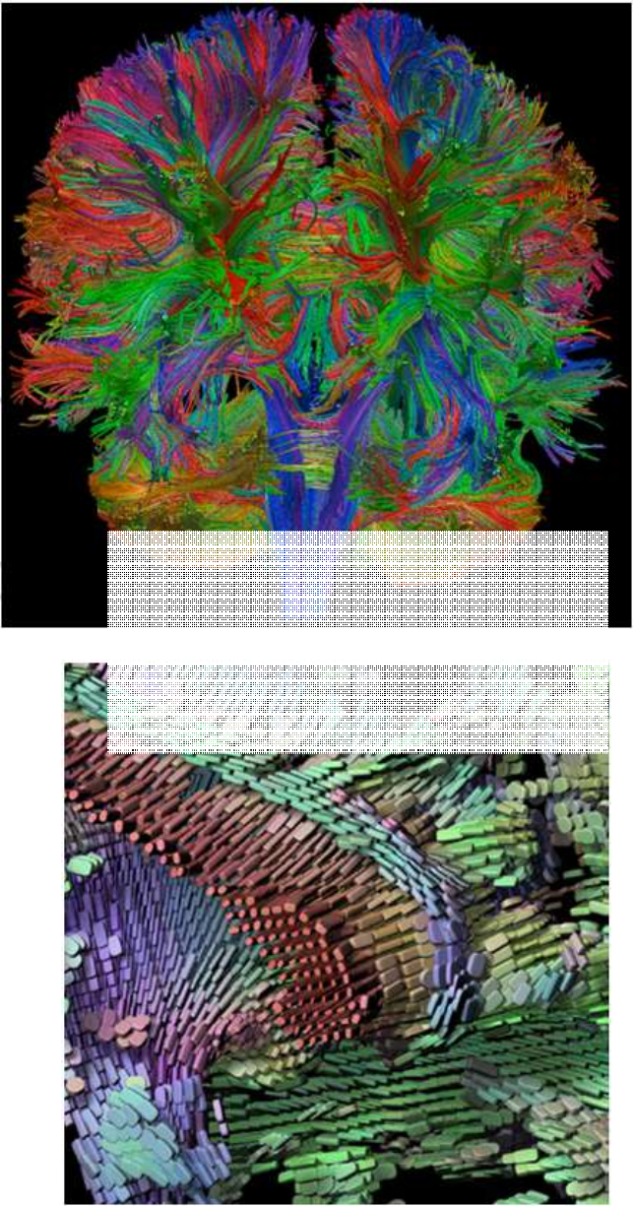

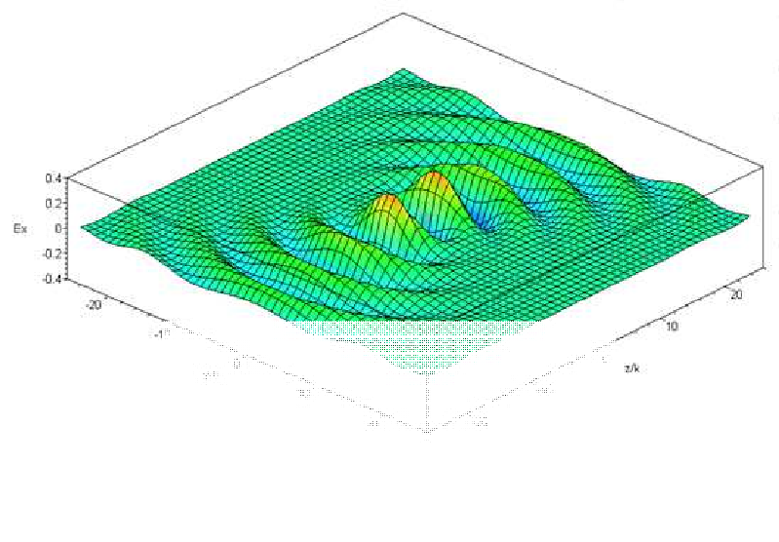
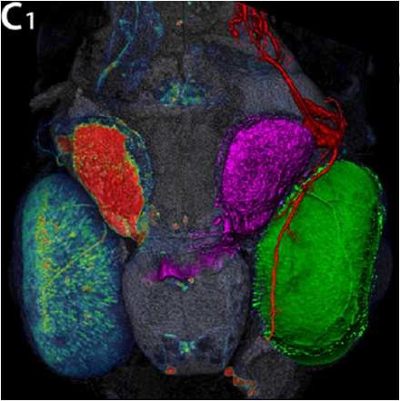
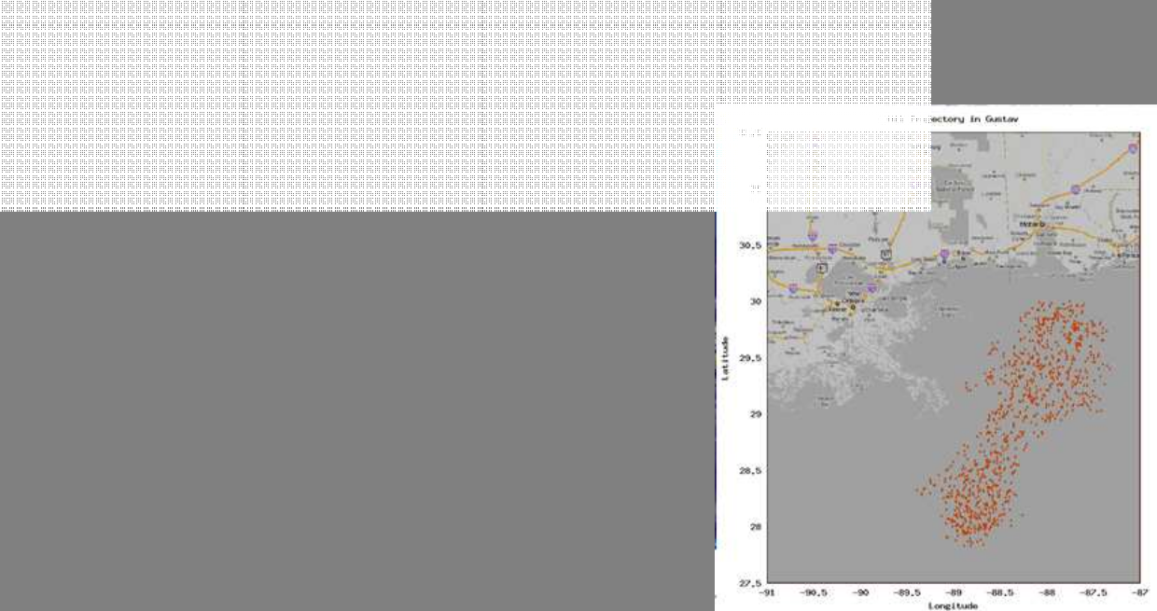
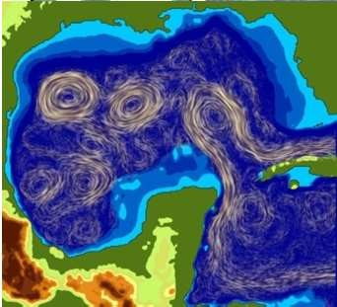
SciVis vs. InfoVis
Scientific visualization is mostly concerned with:
Data defined in physical space, i.e. spatio-temporal data (2~4 dimensions)
Data describes continuous events in continuous space, however, the representation is discrete (i.e. sampled data)
Examples include simulation and measurement data from physics, chemistry, geo-science, medical-biological, climate, oceanography, energy, ……
Features are well-defined
i
n cr n
• Information v
– high-dime
– Data is dis
– Examples i
…...
sualization focuses on:
sional (>>4), abstract data (i.e. tree, graphs, ete in the nature
clude financial, marketing, HR, statistical, so
not well-defined, the typical analysis tasks i usters, voids, outliers
…)
cial
media, political,
ding finding
Scalar
– Feature patterns
are
, cl
Vector-valued
nclu
Tensor
(Bruno Jobard, Gordon Erlebacher, and M
. Yousuff Hussaini)

Slide 25
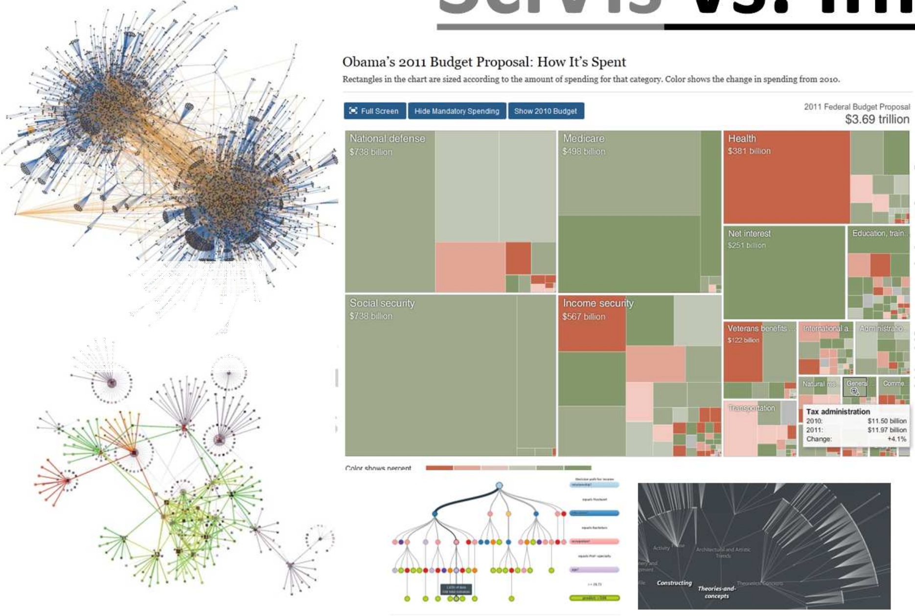
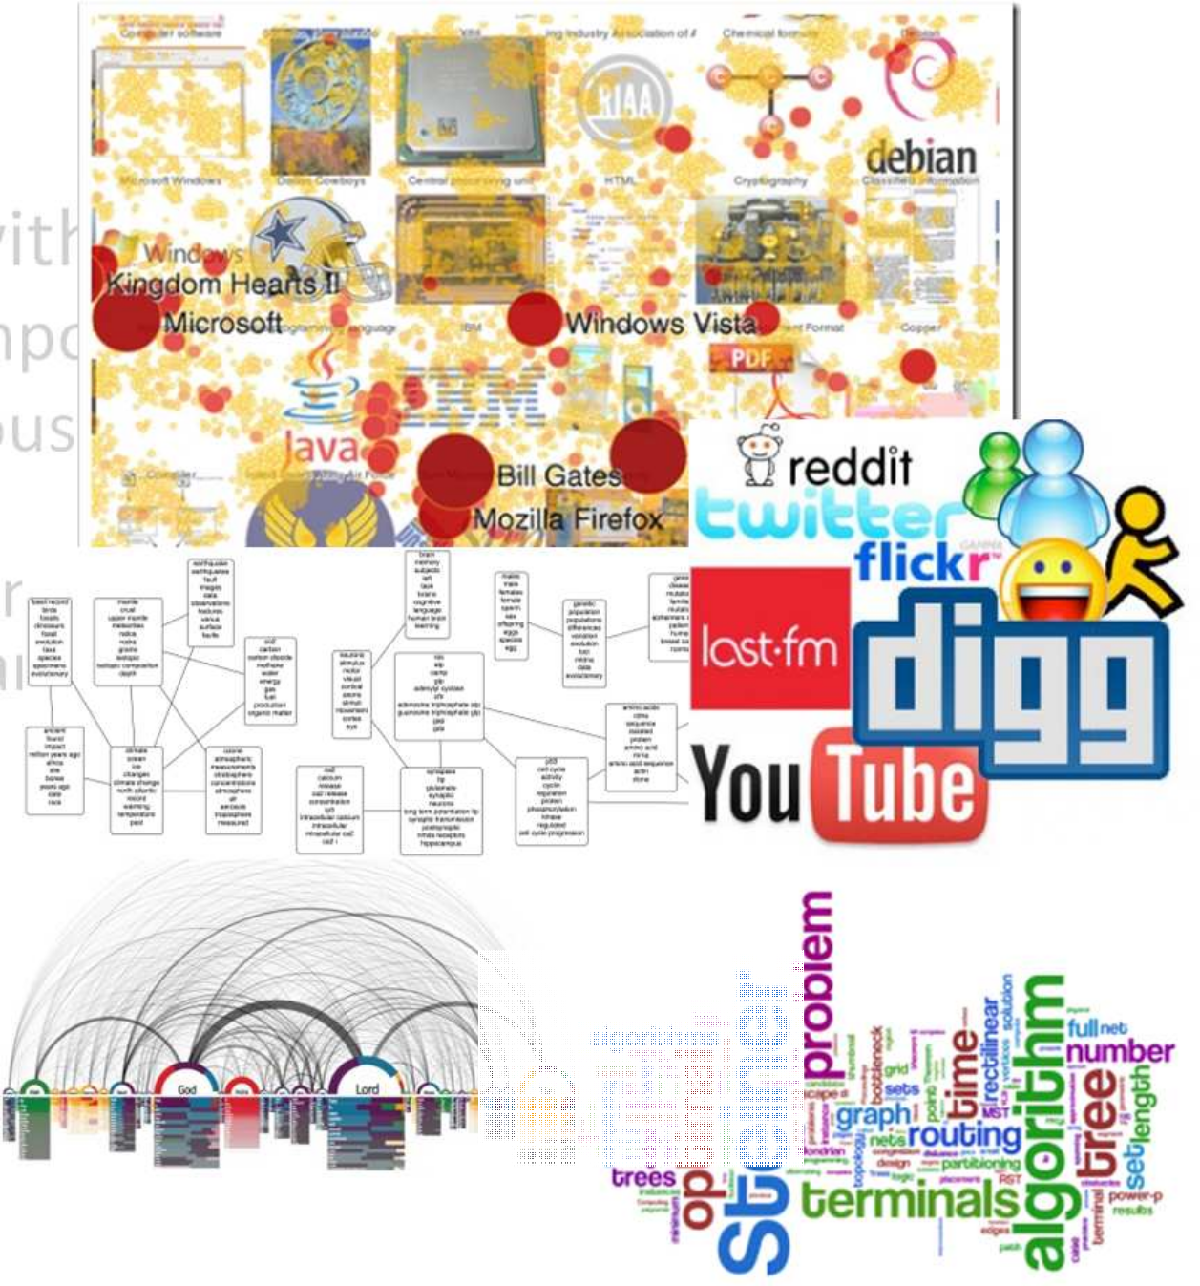




SciVis vs. InfoVis
w
• Scientific visualization is mostly concerned
– Data defined in physical space, i.e. spatio-te
– Data describes continuous events in continu representation is discrete (i.e. sampled data)
ith:
mporal data (2~4 dimensions) us space, however, the
nt data from physics, chemistry, anography, energy, ……
Hierarchy
o
Unstructured
Graph
– Examples include simulation and measureme geo-science, medical-biological, climate, oce
– Features are well-defined
Tree
Text
Information visualization focuses on:
high-dimensional (>>4), abstract data (i.e. tree, graphs, hierarchy, …)
Data is discrete in the nature
Examples include financial, marketing, HR, statistical, social media, political,
…...
Feature are not well-defined, the typical analysis tasks including finding patterns, clusters, voids, outliers

Slide 26








Use the Right Transfer Function Color Scale
to Represent a Range of Scalar Values
Gray scale
Intensity Interpolation
Saturation interpolation
Two-color interpolation
Rainbow scale
Heated object interpolation
Blue-White-Red
Low
High
Given any 2 colors, make it intuitively obvious which represents “higher” and which represents “lower”

Slide 27

Do Not Attempt to Fight Pre Established Color Meanings
Do Not Attempt to Fight Pre-Established
Color Meanings

Slide 28
Examples of Pre-Established Color Meanings
Red
Stop Off
Dangerous Hot
High stress Oxygen Shallow Money loss
Green
On Plants Carbon Moving Money
Blue
Cool Safe Deep Nitrogen

Slide 29
Use good contrast as human eye is good at difference

Slide 30

Color Alone Doesn’t Cut It

Slide 31
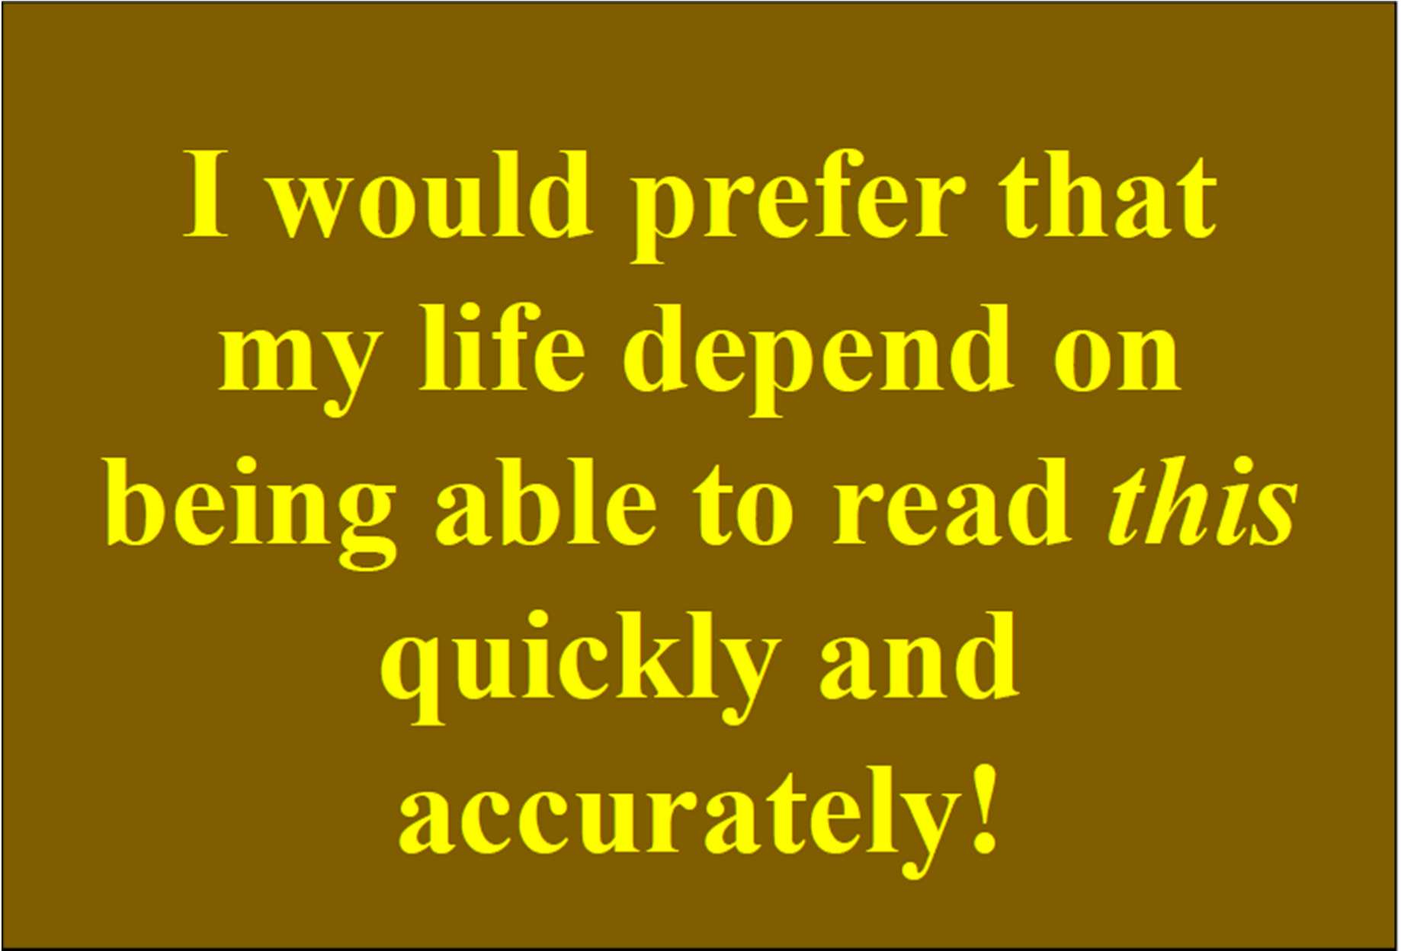
Luminance Contrast is Crucial

Slide 32
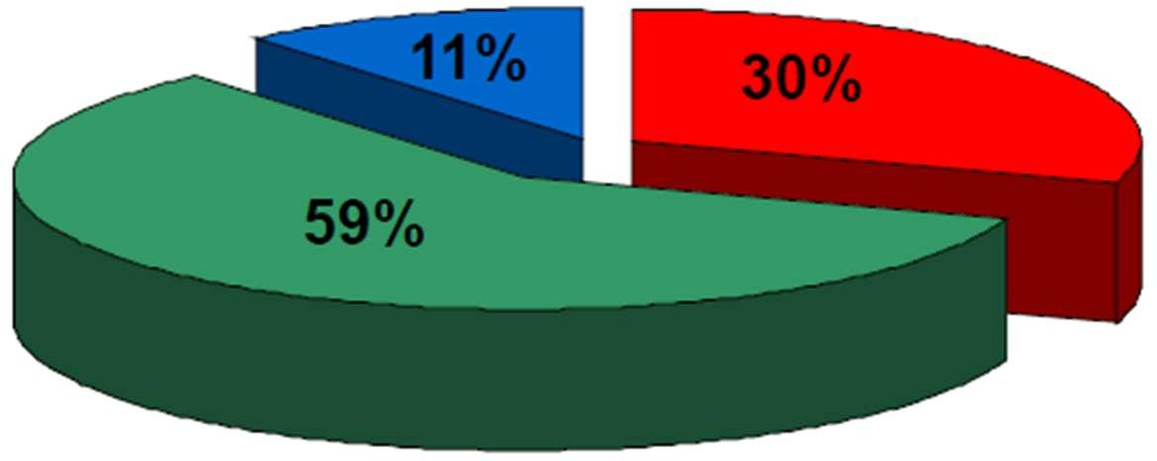
The Luminance Equation
𝑌 = 0. 3 × 𝑅e𝑑 + 0. 59 × 𝐺𝑟ee𝑛 + 0. 11 × 𝐵𝑙𝑢e
Material from Dr. Mike Bailey, Oregon State Univ.

Slide 33
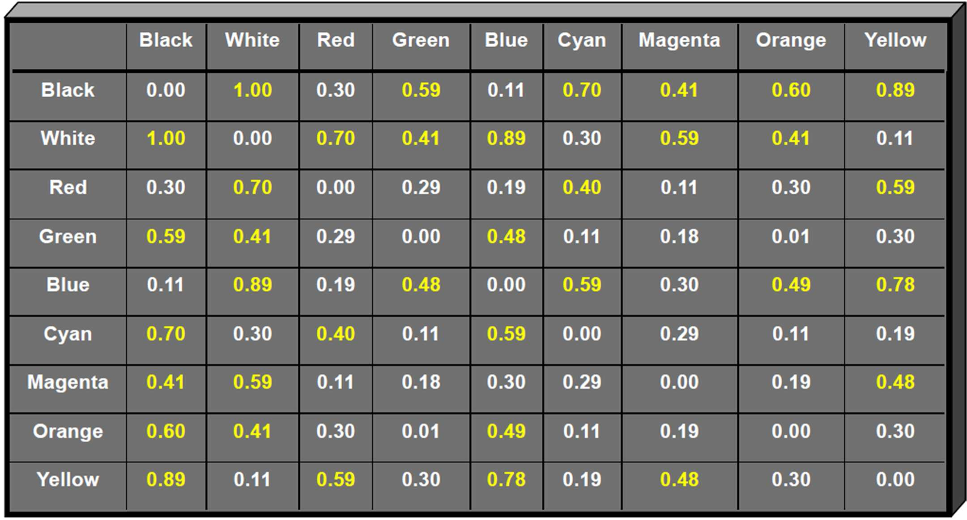
≈ Contrast Table
ΔL* of about 0.40 are highlighted and recommended

Slide 34


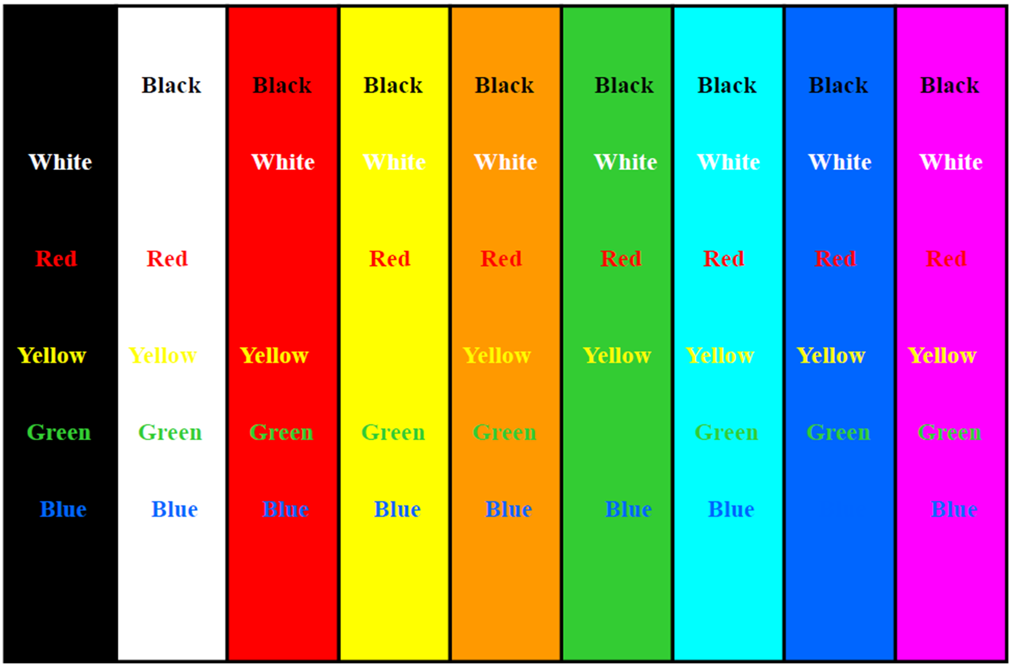
Use good contrast
Use good contrast
ΔL* of about 0.40 makes good contrast
ΔL* of about 0.40 makes good contrast
Material from Dr. Mike Bailey, Oregon State Univ.

Slide 35
Be Aware of the Different Color Ranges on Different Devices

Slide 36
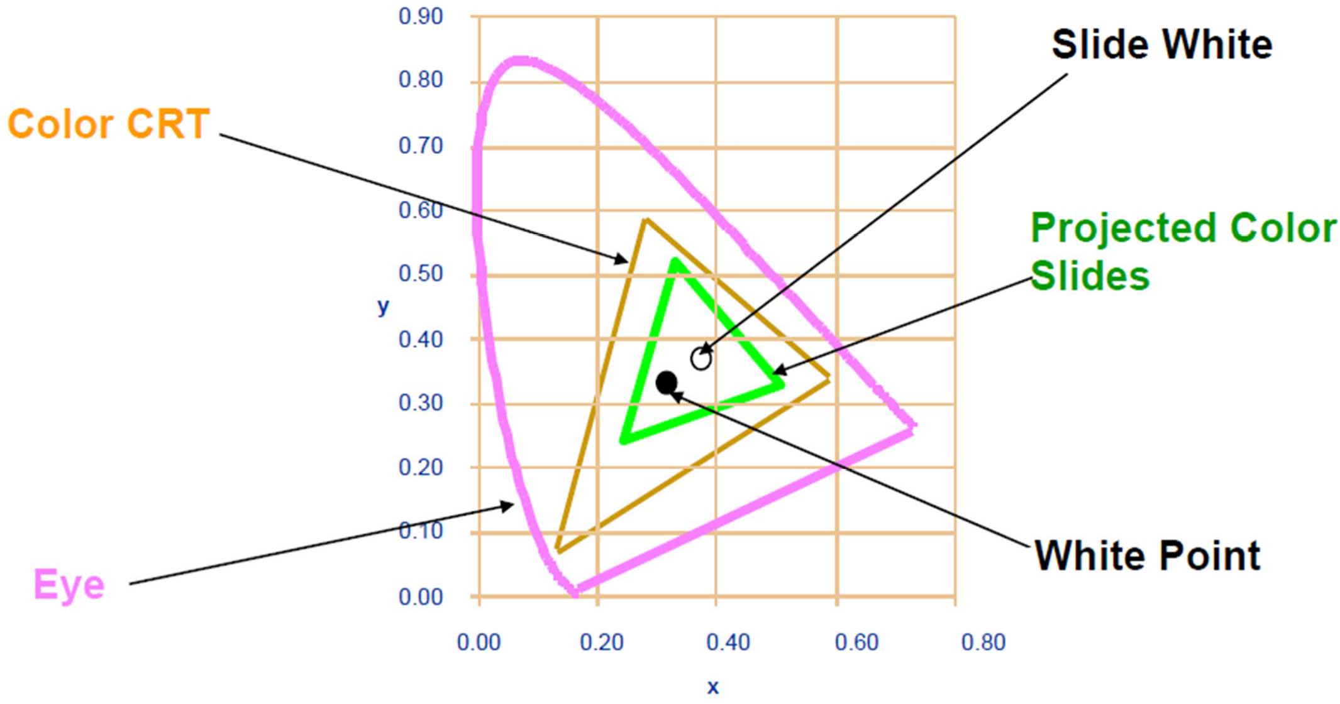
Color Gamut for a Monitor and Color Slides

Slide 37


Beware of Color Pollution
Beware of Color Pollution
Just because you have millions of colors to choose from

Slide 38
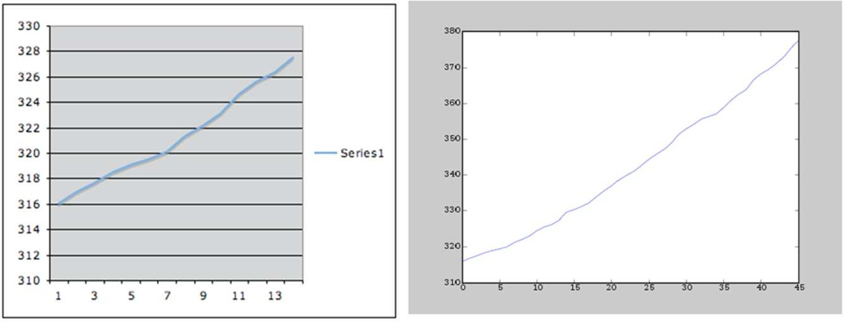
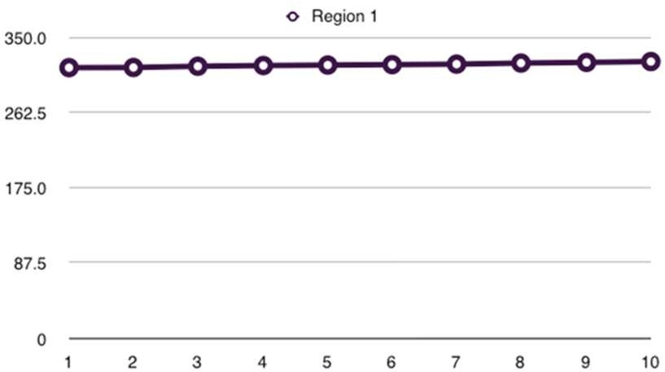
Why are they all different?
What is good/bad about each?

Slide 39
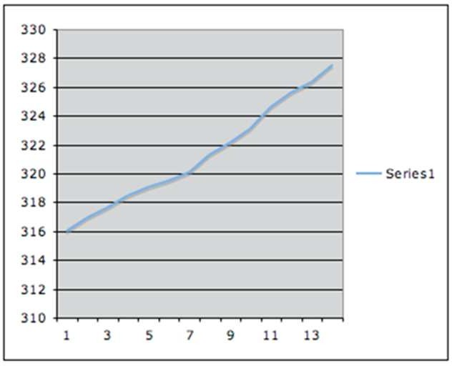
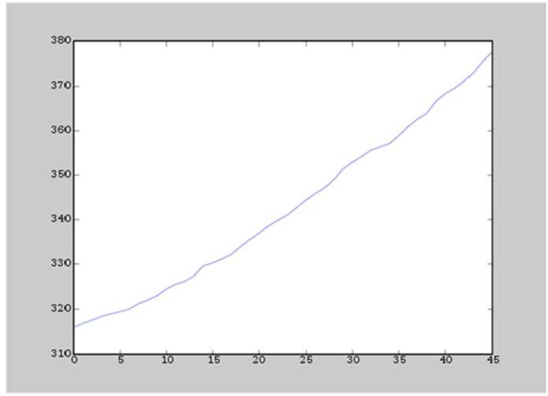
Improving he Vision
Principle 1: Reduced clutter, Make data stand out
– The main focus of a plot should be on the data itself, any superflous elements of the plot that might obscure or distract the observer from the data needs to be removed.
Which one is better?

Slide 40
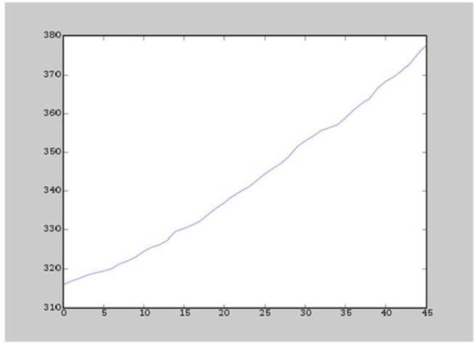
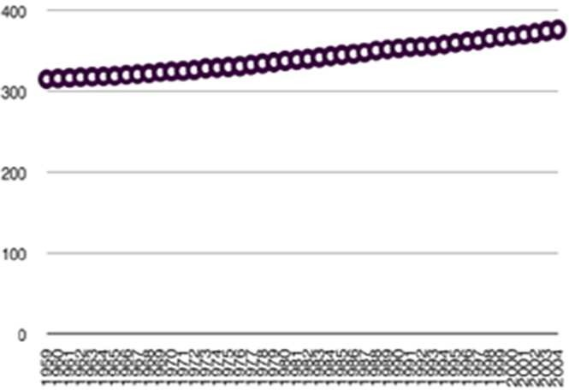
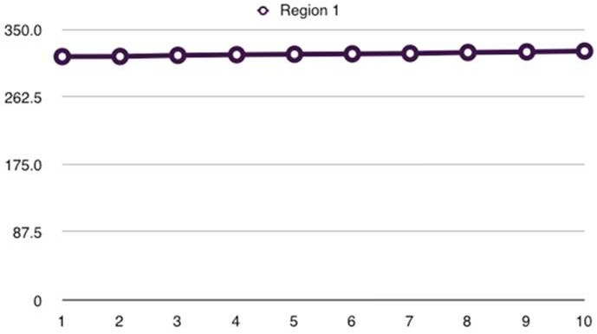
Improving the Vision
Principle 2: Use visually prominent graphical elements to show the data.
Connecting lines should never obscure points and points should not obscure each other.
If multiple samples overlap, a representation should be chosen for the elements that emphasizes the overlap.
If multiple data sets are represented in the same plot (superposed data), they must be visually separable.
If this is not possible due to the data itself, the data can be separated into adjacent plots that share an axis

Slide 41
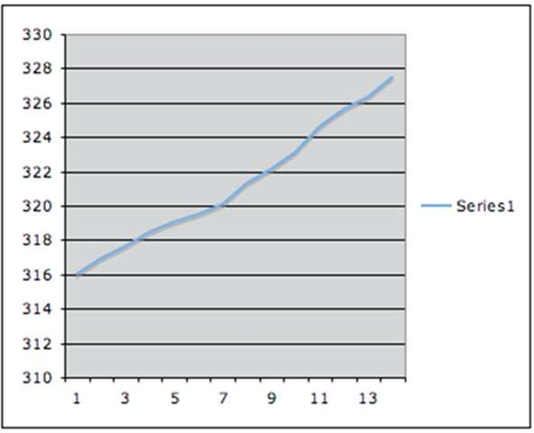
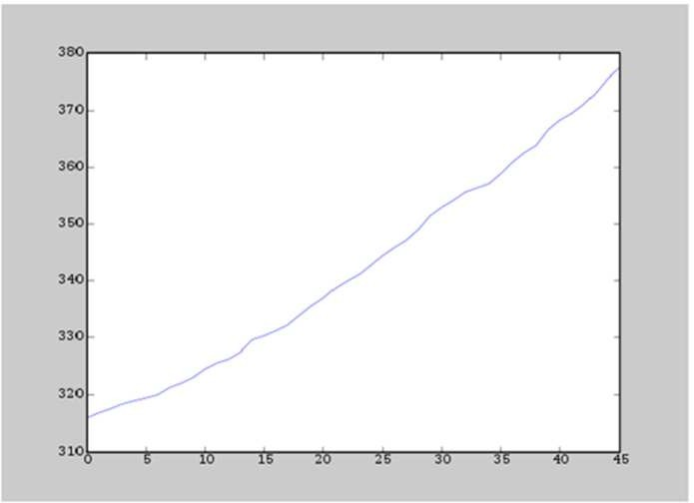

Improving the Vision
Principle 3: Use proper scale lines and a data rectangle.
Two scale lines should be used on each axis (left and right, top and bottom) to frame to data rectangle completely.
Add margins for data
Tick-marks outs and 3-10 for each axis

Slide 42
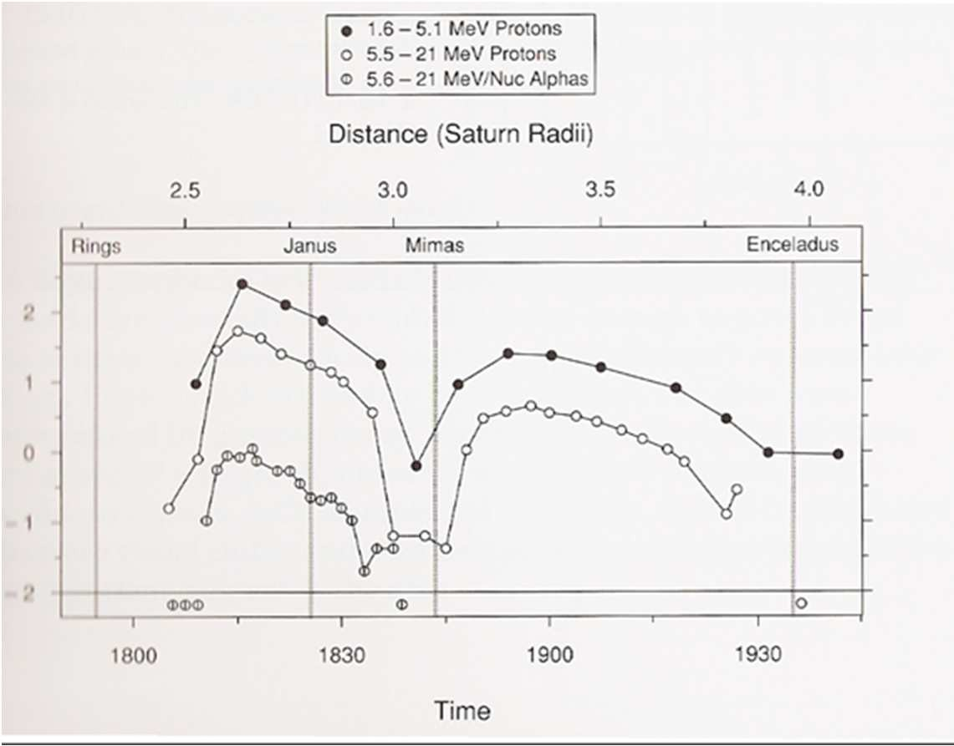
Improving the Vision
Principle 4: Reference lines, labels, notes, and keys.
– Only use them when necessary and don’t let them obscure data.

Slide 43
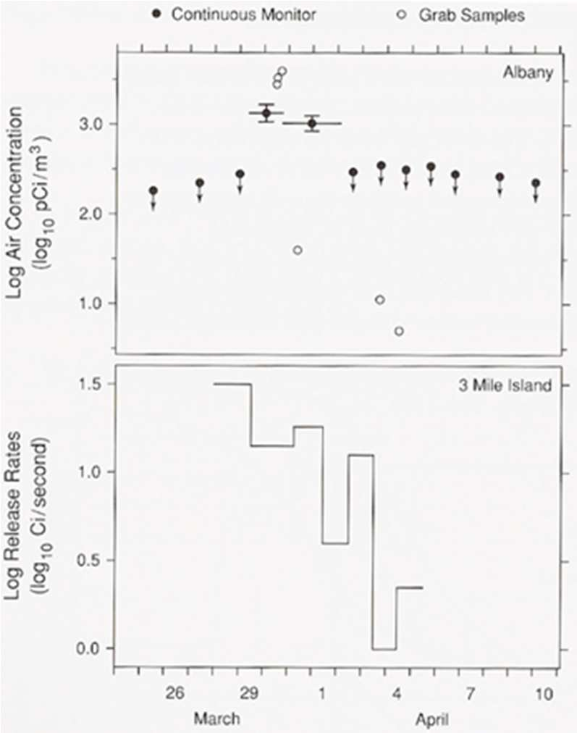
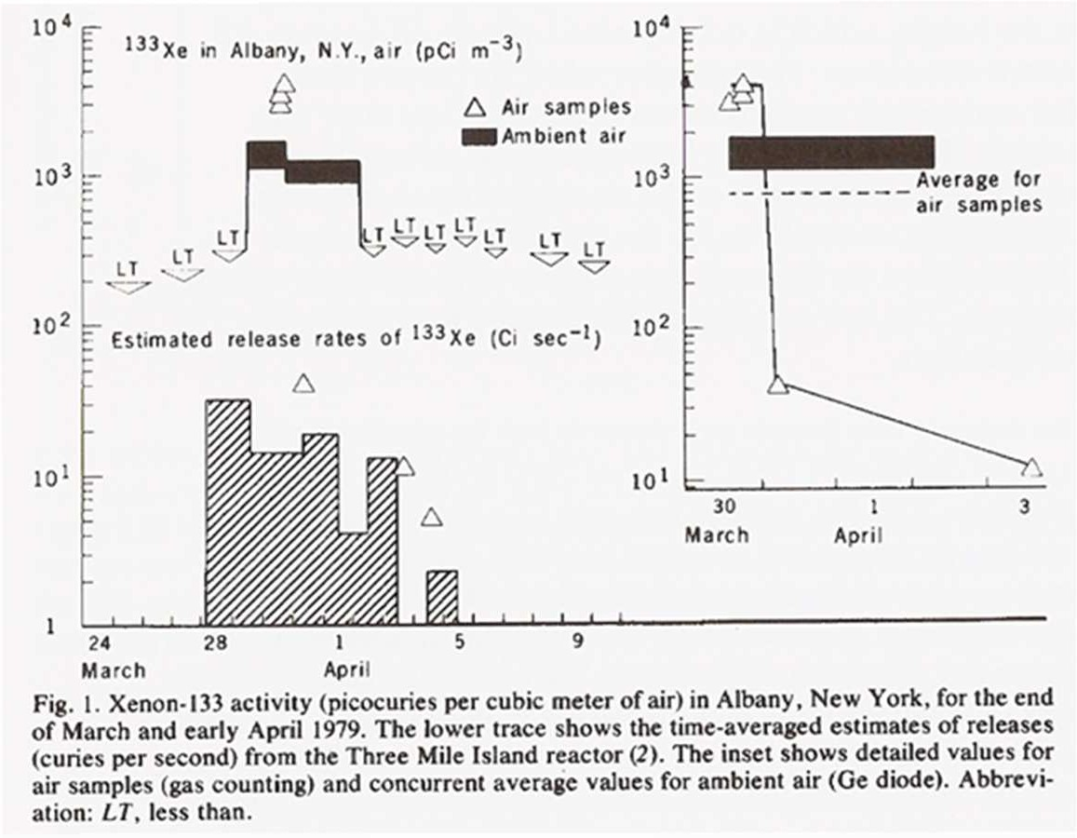
Improving the Vision
Principle 4: Reference lines, labels, notes, and keys.
– Only use them when necessary and don’t let them obscure data.

Slide 44
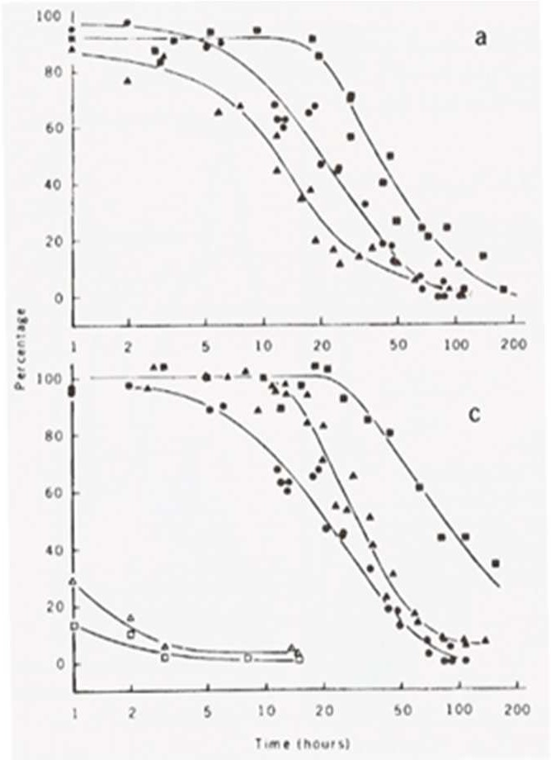
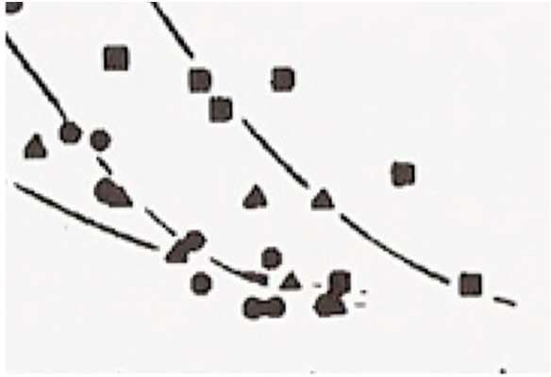
Improving the Vision
Principle 5: Superposed data set
– Symbols should be separable and data sets should be easily visually assembled.

Slide 45
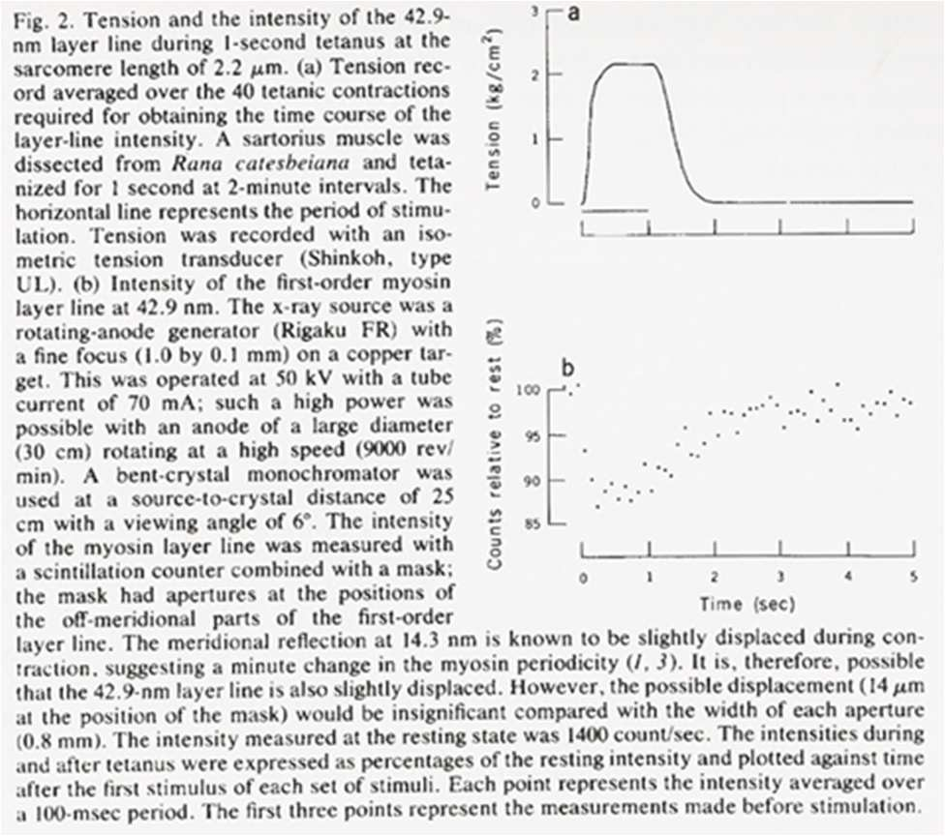
Improving the Understanding
Principle 1: Provide explanations and draw conclusions
A graphical representation is often the means in which a hypothesis is confirmed or results are communicated.
Describe everything, draw attention to major features, describe conclusions

Slide 46
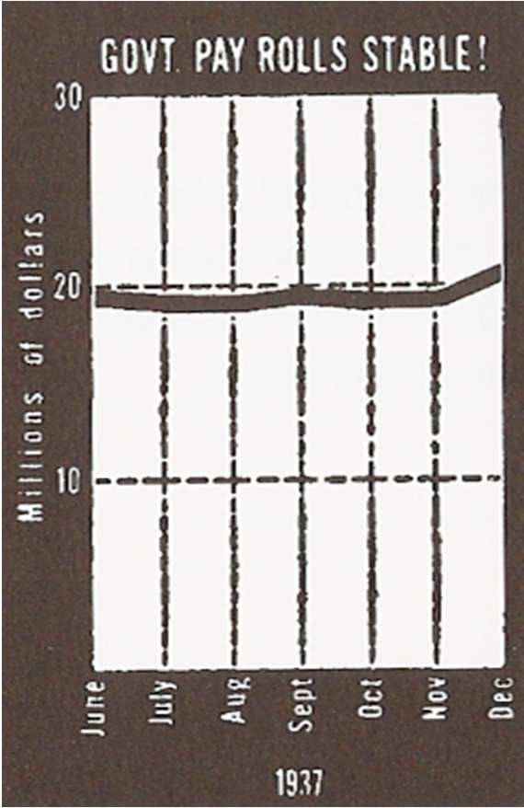
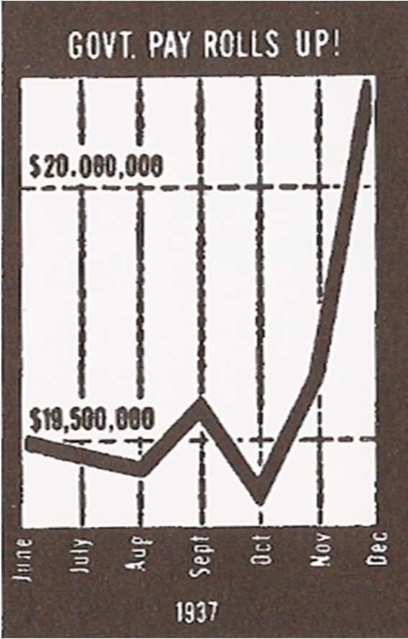
Improving the Understanding
Principle 2: Use all available space.
– Fill the data rectangle, only use zero if you need it

Slide 47
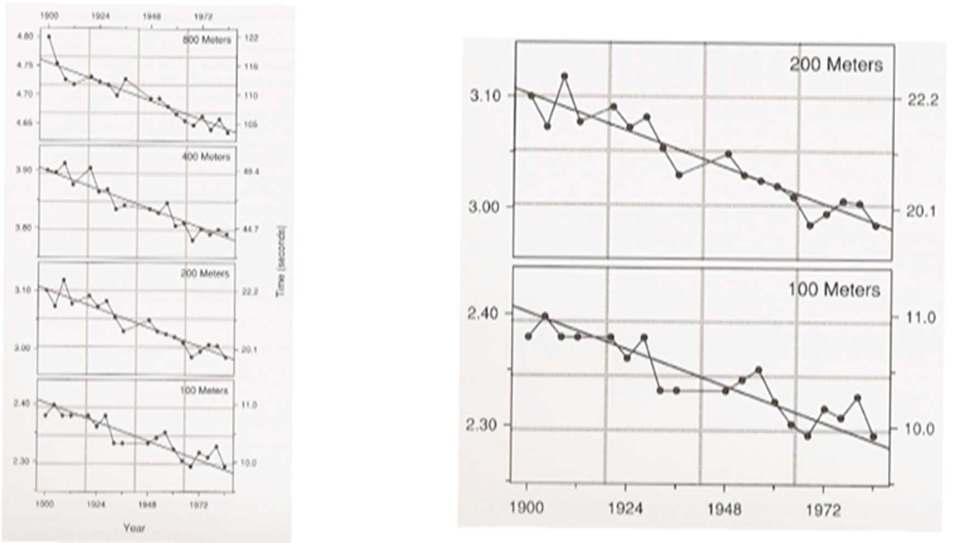
Improving the Understanding
Principle 3: Align juxtaposed plots
– Make sure scales match and graphs are aligned

Slide 48
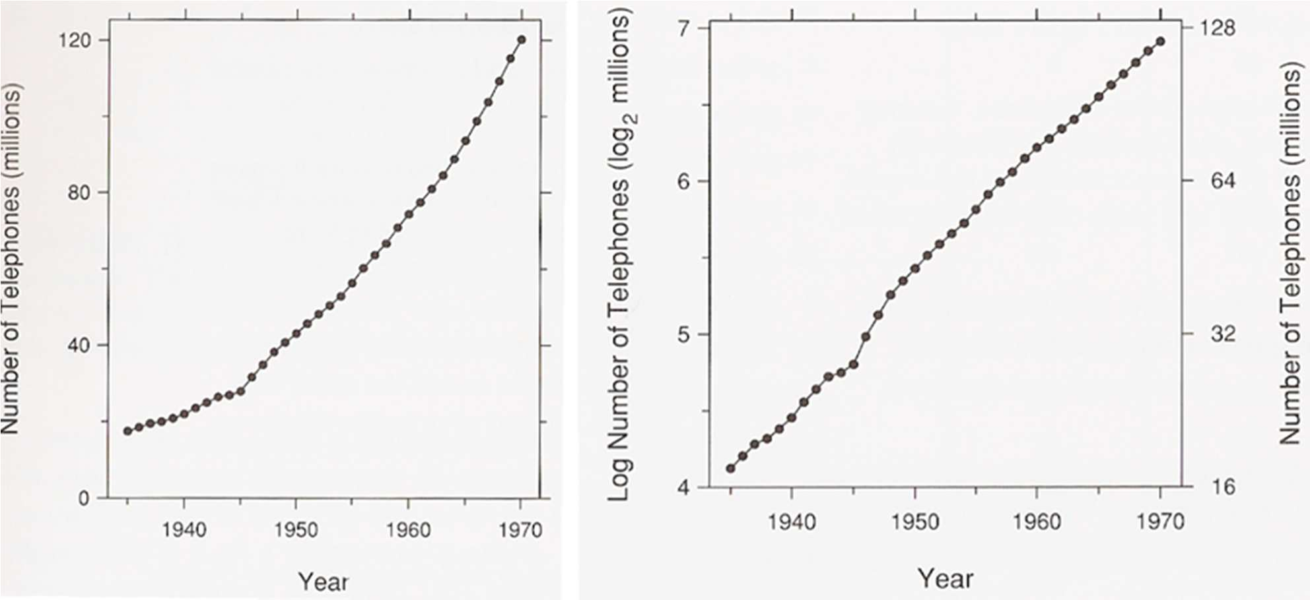
Improving the Understanding
Principle 4: Use log scales when appropriate
– Used to show percentage change, multiplicative factors and skewness

Slide 49
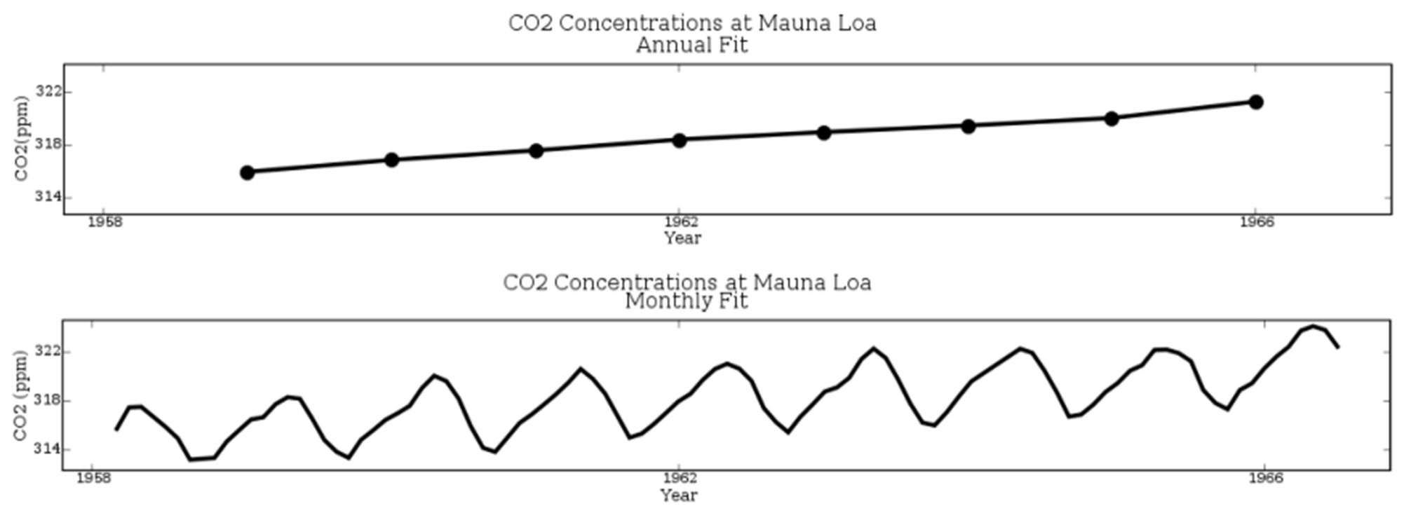
Improving the Understanding
Principle 5: Bank to 45⁰
– Optimize the aspect ratio of the plot

Slide 50
Summary of Principles
Improve vision
Reduced clutter, Make data stand out
Use visually prominent graphical elements
Use proper scale lines and a data rectangle
Reference lines, labels, notes, and keys
Superposed data set
Improve understanding
Provide explanations and draw conclusions
Use all available space
Align juxtaposed plots
Use log scales when appropriate
Bank to 45⁰

Slide 51
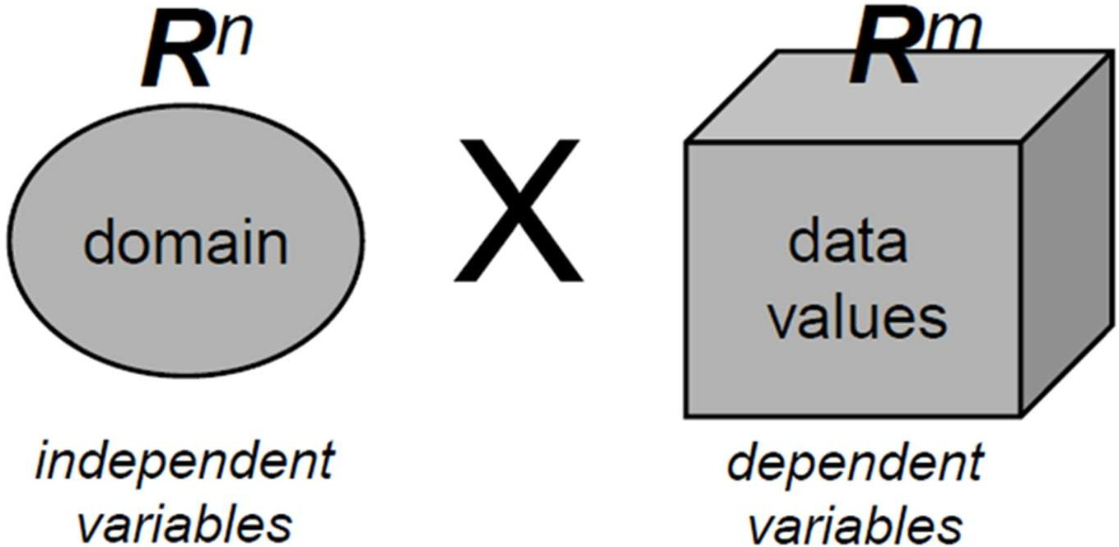
Data we are discussing
Source: VIS, University of Stuttgart
Scientific data
3D+time (n<4)
Scalar/vector/tensor
Information data
nD (n>3)
Heterogeneous

Slide 52



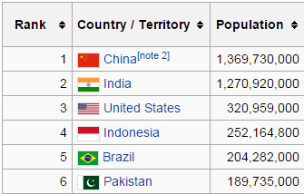

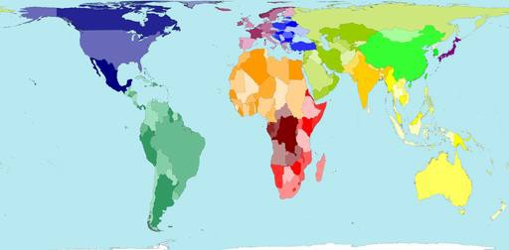
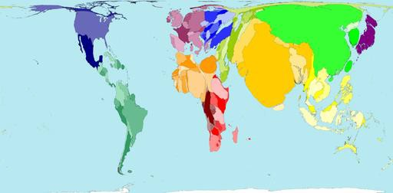


Reality and representation
Real world
In Plato’s allegory of the cave the shadows of real objects is all the spectator sees.
…in the same way, the data is all the analyst sees, and the visualization of that data is all the viewer sees.
But shadows are not reality
Data
But which kind of visualization could better represent the data?
Visual representation

Slide 53

http://www.worldmapper.org/animations/wm01to02.html

Slide 54










Visual cognition process. A general overview
Visual cognition process
The visual cognition process can help people to understand the
sense of data, solve problems and make decisions
Phases
Representation: a mapping
Aims
Communicate and explain
from raw data to a visible
representation
(known ideas)
Analyse and discover
Interaction: changing what is
(unknown reality)
immediately viewable
Evaluate and decide (on
Presentation: organizing this
the basis of graphical evidences)
visible representation into the
space available

Slide 55



Visual cognition building blocks
Raw Data |  |  |  |  | Visual Patterns
Visual representation |  |  |  |  |  | Visual interaction
Visual synthesis |  | Visual presentation |  |  |  |  | Visual exploration |  |  | Visual analysis
Infographic |  |  | GAV | Storytelling |  |  |  |  | Dashboard
Sense-making | Understanding |  |  |  | Problem-solving |  |  | Making decisions
Knowledge cristallization |  |  |  | Knowledge discovery

Slide 56


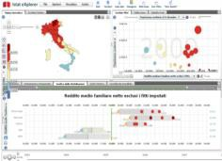








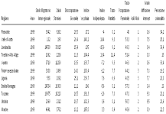



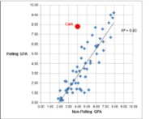
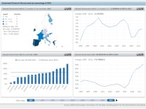









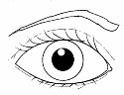
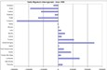
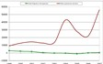









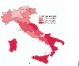



























Visual cognition pipelin
e
Visual
interaction
Exploring
Problem- solving
systems
Raw Data
Visual
interaction
Dashboard
Sense-
Making
Visual
analysis
Visual exploration
Visual
synthesis
Visual
presentation
Visual representation
Visual
interaction
Under-
standing
Visual Patterns
Making decisions
Infographic
Visualization practitioner
Analyst
User
Storytelling

Slide 57

The essence of visual representation
A few words are enough to explain the act of
visualization
“Visualization is about seeing the unseen and
gaining an understanding of the underlying
information”
(J.C.Roberts)
https://kar.kent.ac.uk/21931/1/display_models-ways_roberts.pdf

Slide 58








The generic dataflow model of visual representation
Raw data are preprocessed…
…filtered…
to select the required information
…mapped…
into an Abstract
Visualization Object
…rendered
to generate
the image

Slide 59


















The essence of visual analytics
The (visual) analytics process can be seen as the combination of two human activities that enable to discovery knowledge into the world complex information space: to see and to think
“Discovery consists of seeing what everybody has seen and
thinking what nobody has thought.”
(A. von Szent-Gyorgyi )
Static, rational, passive
Dynamic, instinctive, interactive

Slide 60
Goals underlying visual analytics
The goal of visual analytics is the creation of tools and techniques to enable people to:
Synthesize information and derive insight from massive, dynamic, ambiguous and often conflicting data.
Detect the expected and discover the unexpected.
Provide assessments that can be timely,
defensible, and understandable.
Communicate assessment effectively for action
J.J. Thomas, K.A. Cook, eds. Illuminating the path: The research and development agenda for visual analytics. IEEE Computer Society Press, 2005

Slide 61


The essence of visual communication
Our sense of pattern is an extremely important part of all intellectual activity, and the externalization and representation of pattern in visual communication is... at the core of many advances.
(D. Sless )
“Graphic communication involves transcribing and telling others
what you have discovered.
Its aim: rapid perception and, potentially, memorization of the
overall information.
Its imperative: simplicity”
(J.Bertin)

Slide 62






Visual analytics
Visual analytics integrates scientific disciplines to improve the division of labor between human and machine.
Machine
Human

Slide 63






Visual analytics
Techniques that take advantage of the human eye’s broad bandwidth pathway
into the mind to
allow users to see,
explore, and understand large
amounts of
information
Techniques that enable users to obtain deep insights that
directly support assessment, planning,
and decision making
Visual
at once
Analytics
Techniques to present the results of an analysis
to communicate information in the appropriate context
to a variety of audiences.
That convert all types of conflicting and
dynamic data in ways that support visualization and analysis
http://vis.pnnl.gov/pdf/RD_Agenda_Visu alAnalytics.pdf

Slide 64






Visual patterns useful for data understanding
High – Low - In between
Up – Down - Plateau
Steep - Gradual
Steady - fluctuating
Random - repeating Leading - lagging
Stephen Few, Now You See It: Simple Visualization Techniques for Quantitative Analysis, Analytics Press, 2009

Slide 65






Visual patterns useful for data understanding
Non-intersecting
- intersecting
Symmetrical -skewed
Normal - abnormal
Tightly - loosely
distributed
Wide - narrow
Clusters - gaps
Stephen Few, Now You See It: Simple Visualization Techniques for Quantitative Analysis, Analytics Press, 2009

Slide 66
Analysis: what, why, and how
What is shown?
Data abstraction
Why is the user looking at it?
Task abstraction
How is it shown?
Visualization + interaction
What?
Why?
How?
Notes:
visualization analysis and design framework
But what is analysis? What are we analyzing? And why?

Slide 67
Analysis: what, why, and how
Answering what & why serve as constraints on design space
What?
Why?
How?

Slide 68




It all starts with data
Notes:
Visualization pipeline, always starts with data

Slide 69
Data collection and generation
Big topic! Not addressed in this course.
Many data collection methods
Sensors
Logs
Experiments
Human-generated data
Surveys

Slide 70
Data transformation/processing
Big topic! Not fully addressed in this course.
Data cab ne transformed in many ways
aggregated
collated
Sub-setted
filtered
Reshaped
Change of scale
…

Slide 71
Data abstraction
Is about understanding your data
Type
Number?
Category?
Organization
Table?
Network?
Semantics
Meaning of it
Notes:
Data can be abstracted in a million different ways and there is a lot of research in databases on that. But this abstraction is structured in a way to be useful to the visualization designer.

Slide 72
Data abstraction
14, 2.6, 30, 30, 15, 100001
(14, 2.6, 30) , (30, 15, 100001)
(14, 2.6) , (30, 30) , 15 , 100001
Point A
Point B
Point A
Point B
Links
Weight
Notes:
Data abstraction is about understanding your data.
Lets start this an example?
What does this sequence of six numbers mean?
Two faraway points in 3D space?
Or
Two closer points in 2D space, with 15 links between them, and 100001 assigning weight to links?

Slide 73
Data abstraction
14, 2.6, 30, 30, 15, 100001
Two necessary crosscutting piece of information to move beyond guesswork
Semantics
Types

Slide 74
Data abstraction
Semantic of data is its real-world meaning
Link
Road?
Friendship?
Hierarchy?
Word
Frist name?
company name?
fruit?
Number
Day of a month?
age?
height?

Slide 75
Data types
Attribute is something that can be measured, observed, or logged
Salary, price, protein expression level,…
Item is an individual entity that is discreet
People, stocks, coffee shops, genes,…
Link is a relationship between items
Position a location in (2D) or (3D) space
Latitude-longitude
Grid is strategy used for sampling continuous data
Notes:
Five basic data types

Slide 76

Attribute types
Attribute is something that can be measured, observed, or logged

Slide 77
Attribute types
Categorical (e.g., gender, race, eye color)
Ordinal (e.g., edu level, position in a race)
Quantitative (e.g., age, height, weight)

Slide 78

Attribute types

Slide 79

Dataset types
Four basic database types
Combination of data types
In real-word, complex combination of these types are common
Notes:
A dataset is a collection of information that is the target of analysis
Four basic datatypes
The field dataset type also contains attribute values associated with cells.1 Each cell in a field contains measurements or calculations from a continuous domain

Slide 80

Dataset types
Notes:
This image shows the internal structure of the four basic dataset types in detail.
Tables have cells indexed by items and attributes, for either the simple flat case or the more complex multidimensional case.
In a network, items are usually called nodes, and they are connected with links; a special case of networks is trees.
Continuous fields have grids based on spatial positions where cells contain attributes.
Spatial geometry has only position information.

Slide 81
Dataset types
Fields
Grid
Positions
Attributes: values associated with cells
Cells: contains measurements or calculations from a continuous domain
Notes:
Five basic data types

Slide 82
Fields (spatial)
Medical scan of a human body containing measurements indicating the density of tissue at many sample points
Animals movements
Election results in counties
Simulation of air turbulence

Slide 83
Dataset types
Geometry
Items
Positions
Specifies information about the shape of items with explicit spatial positions. The items could be points, or one-dimensional lines or curves, or 2D surfaces or regions, or 3D volumes.
Notes:
Five basic data types

Slide 84
Dataset types
Geometry datasets are intrinsically spatial
They typically occur in the context of tasks that require shape understanding
Geometry datasets do not necessarily have attributes, in contrast to the other three basic dataset types
Notes:
Five basic data types

Slide 85
Cardinality
Effectiveness of data visualization is impacted by:
Visual encoding
Type of task
Distribution of data
Various measures describe data distribution
Cardinality: number of unique values for an attribute
Entropy
Clusterdness
…
Notes:
In the context of databases, cardinality refers to the uniqueness of data values contained in a column. High cardinality means that the column contains a large percentage of totally unique values. Low cardinality means that the column contains a lot of “repeats” in its data range.

Slide 86

Cardinality
Notes:
Read a value

Slide 87

Data abstraction
Data types & datasets→ templates to help you understand & describe your data

Slide 88
Task abstraction
Why is the user looking at it?
Task abstraction
Goal: transform user task from a domain specific language into a high-level concise representation
What?
Why?
How?

Slide 89
Task abstraction
A biologist studying immune system response might describe her task as:
“I want to see if the results for the tissue samples treated with LL-37 match up with the ones without the peptide”
Compare values between two groups

Slide 90
Task abstraction
Business manager:
“I want to see if new marketing strategy was successfully resulted in selling more products in the home appliances category”
Trends for a group of products

Slide 91
Task abstraction
You need to collect user’s tasks (questions) frist
Interview
Brainstorming
Focus groups
Exploratory prototypes
Observation
Surveys
…

Slide 92

Task abstraction
Domain questions
“why are there so may failed requests today?”
Abstract tasks
Identify
Analyze
…

Slide 93

Task abstraction
Task classification
Domain questions
“why are there so may failed requests today?”
Abstract tasks
Identify extremums
Analyze outliers
…

Slide 94
Task abstraction
There are many classifications and taxonomies for visualization tasks
Low-level
Example: Retrieve value, Filter, Order, Find extremums,…
Further reading: Low-Level Components of Analytic Activity in Information Visualization (Amar et al., 2005)
High-level
Example: Explore, Describe, Explain,…
Further reading: Bridging From Goals to Tasks with Design Study Analysis Reports

Slide 95

Task abstraction
Specificity
#Population
We will follow task classification by LAM, Tory & Munzner, 2017
Notes:
9 goals (in black bold)
2 axes
Specificity indicates the degree of selectiveness of the analysis goal in pursuit of the expected outputs.
# population is about the scope of data selection, single (all data, a single subset), Multiple (two or more subsets of data)

Slide 96
Task abstraction
Specificity is about scope of analysis, breadth VS depth
# population is about the scope of data selection, single (all data, a single subset), Multiple (two or more subsets of data)
Notes:
9 goals (in black bold)
2 axes
Specificity indicates the degree of selectiveness of the analysis goal in pursuit of the expected outputs.
# population is about the scope of data selection, single (all data, a single subset), Multiple (two or more subsets of data)

Slide 97
Task abstraction
Population Definition (Pop Defn) describes how to select (filter) data to get the desired subset

Slide 98
Task abstraction
Discover observation
“I want to know more about how we handled booking requests today”
“Many failed request today!”
A subset of data for today’s requests
Describe observation
“what type of requests were failed the most?”
“Class Z and R failed the most! and error code is 100 that means…”
A subset of data for today’s failed requests

Slide 99
Task abstraction
Identify main cause
“Why class Z & R requests failed today?”
“100% of failed requests are associated with delayed flight number 4360 in location A”
A subset of data for today’s failed requests of type Z & R
“We have a problem with maintenance time that causes delays in many flights from location A”
Confirm
“Reject”
A subset of data for today’s failed requests, locations, maintenance times …

Slide 100
Task abstraction
Tree dataset: items (nodes) and links
“I want to be able to present a path traced between two nodes of interest to a colleague”
Find two interesting nodes == Explore, all nodes
What defines interesting?
# number of childeren
Find the path between those two nodes == Describe, observed nodes & their connections

Slide 101


Task abstraction
Find nodes → find path→ present
Tree, icicle layout
Arc tree
Ranked list of nodes
Ordering supports exploration
Ordering supports exploration
Layout, supports description

Slide 102
Task abstraction
Find nodes → find path→ present
5
3
2
Notes:
Find nodes
Find path
Show the selected path to a colleague

Slide 103
Task abstraction
It is not easy! It takes lots of practice and (failed) attempts to master it
It is highly iterative!
People are not very good at describing their tasks
Incomplete
Incorrect
Some times even contradicting

Slide 104

Derive: Crucial design choice
Don’t just draw what you are given!
Decide what the right thing to show is
Create it with a series of transformations from original dataset
Draw that!
Deriving is one of our major strategies for handing complexity

Slide 105
Visual Encoding

Slide 106
Overview
What is a visual encoding?
How can it amplify our cognition?
How do we map data into a visual form?
What kinds of information visualization exist?

Slide 107
Visual Encoding Defined
“Visual encoding is the mapping of information to display elements”
Tamara Munzner, Ph.D. dissertation http://graphics.stanford.edu/papers/munzner_thesis/

Slide 108
“. . . [H]uman intelligence is highly flexible and adaptive, superb at inventing procedures and objects that overcome its own limits. The real powers come from devising external aids that enhance cognitive abilities.

Slide 109
“How have we increased memory, thought, and reasoning? By the invention of external aids: It is things that make us smart.”
- Don Norman

Slide 110
Amplifying Cognition
Increased resources
Reduced search
Enhanced recognition of patterns
Perceptual inference
Perceptual monitoring
Manipulable medium

Slide 111

Poor Encodings ...
May reduce task performance
May make information hard to find
http://www.research.ibm.com/dx/proceedings/pravda/truevis.htm

Slide 112

Or worse ...
The Challenger shuttle disaster was linked to a misunderstood diagram

Slide 113

Knowledge Crystallization
The general process used when people have a task to complete

Slide 114
Infovis at Different Levels
Infosphere
Information workspace
Visual knowledge tools
Visual objects

Slide 115

Looking for Benefits
A Cost of Knowledge Characteristic Function maps the cost of an operation to the benefit of doing it
An effective function should reduce the cost / increase the benefit

Slide 116

Mapping Data to Visual Form

Slide 117
Raw Data
Usually represented as a relation or set of relations to give it some structure
A relation is a set of tuples in the form: <value_{ix}, value_{iy}>, <value_{jx}, value_{jy}> ...

Slide 118

Data Tables
Contain data and metadata

Slide 119
Note:
Dimensionality can have different meanings:
number of input variables
number of output variables
number of input and output variables
number of spatial dimensions in data

Slide 120
Data Transformations
Four types of data transformations:
Values to derived values
Structure to derived structure
Values to derived structure
Structure to derived values

Slide 121


Slide 122


Slide 123


Slide 124
Visual Structures
Basic building blocks include:
Position
Marks
Connections
Enclosure
Retinal properties
Temporal encoding

Slide 125
Position
Fundamental aspect of visual structure
Four possible axes: unstructured, nominal, ordinal, quantitative
Techniques to maximize its use:
Composition
Alignment
Folding
Recursion
Overloading

Slide 126
Marks
Four types:
points
lines
areas
volumes

Slide 127
Connections and Enclosure
Connections show a relationship between objects
Enclosure can also indicate related objects

Slide 128

Retinal Properties
Include colour, size, texture, shape, orientation

Slide 129
Temporal Encoding
Humans are very sensitive to changes in mark position and their retinal properties
Data shown may or may not be time-based

Slide 130
View Transformations
Make a static presentation interactive
Three common transformations:
Location probes
Viewport controls
Distortions

Slide 131

Scientific Visualization

Slide 132

GIS

Slide 133

Multi-Dimensional Scattergraphs

Slide 134

Worlds-Within-Worlds

Slide 135

Multi-Dimensional Tables

Slide 136

Information Landscapes

Slide 137

Node and Link Diagrams

Slide 138

Trees

Slide 139

Special Data Transforms

